Slide 1
Weekly reflection

Slide 2
The inequality of climate change

Slide 3
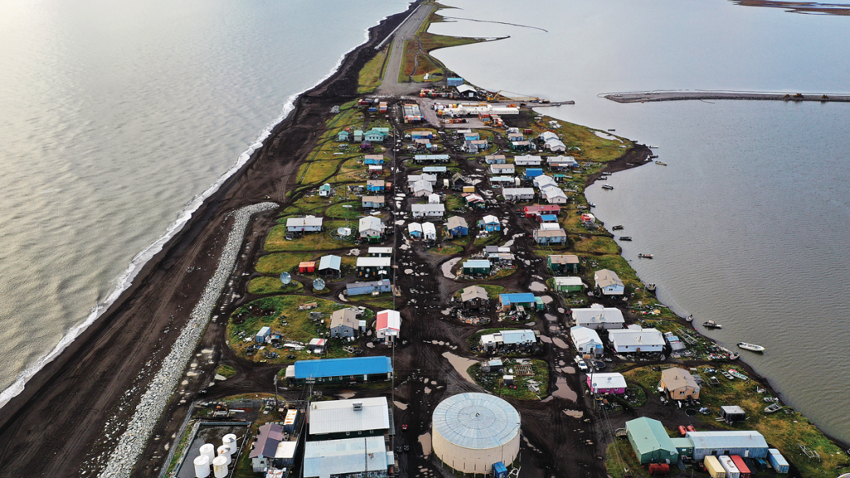

Slide 4
Continued discussion
“In general, I have some frustration with using these geographically distant examples of how climate change is affecting communities… I think using these distant examples can make the effects of climate change feel more futuristic for us and gives us a sense of insulation from them when in reality it is also affecting marginalized and under-supported communities closer to home.”
“I honestly didn't think much about the immediate effects of climate change. In my day-to-day life, I don't notice much difference over the last 20 years. However, seeing how people's lives in Alaska have been altered has put climate change in a new light for me… I assumed it would happening 20-50 years from now. The video left me more passionate about preserving Earth’s equilibrium than before.”
“By continuing to learn about the struggles of communities like Kivalina, the conversation around climate change becomes a more humanistic and moral issue rather than an generalized one. I hope myself and the population as a whole can learn more about communities facing the worst of climate change, so we can take responsibility, advocate for, and offer support to those struggling.”

Slide 5
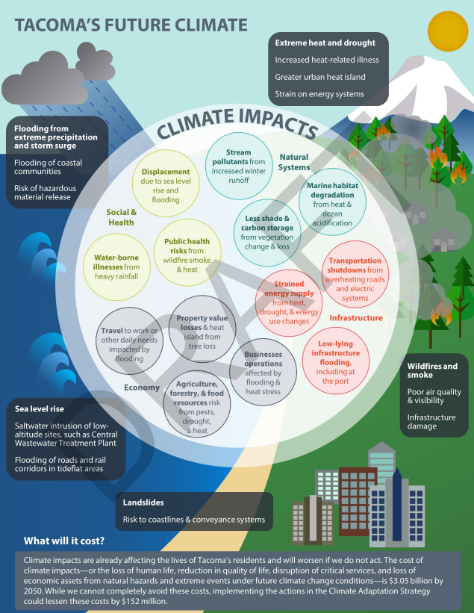
Climate impacts on Tacoma
Extreme heat and drought
Increased heat-related illness
Greater heat island effect
Strain on energy systems
Wildfires and smoke
Poor air quality and visibility
Infrastructure damage
Landslides
Risk to coastlines and conveyance systems
Sea level rise
Saltwater intrusion of low-altitude sites like the Central Wastewater Treatment Plant
Flooding of roads and rail corridors
Flooding from extreme precipitation and storm surges
Flooding of coastal communities
Risk of hazardous material release

Slide 6
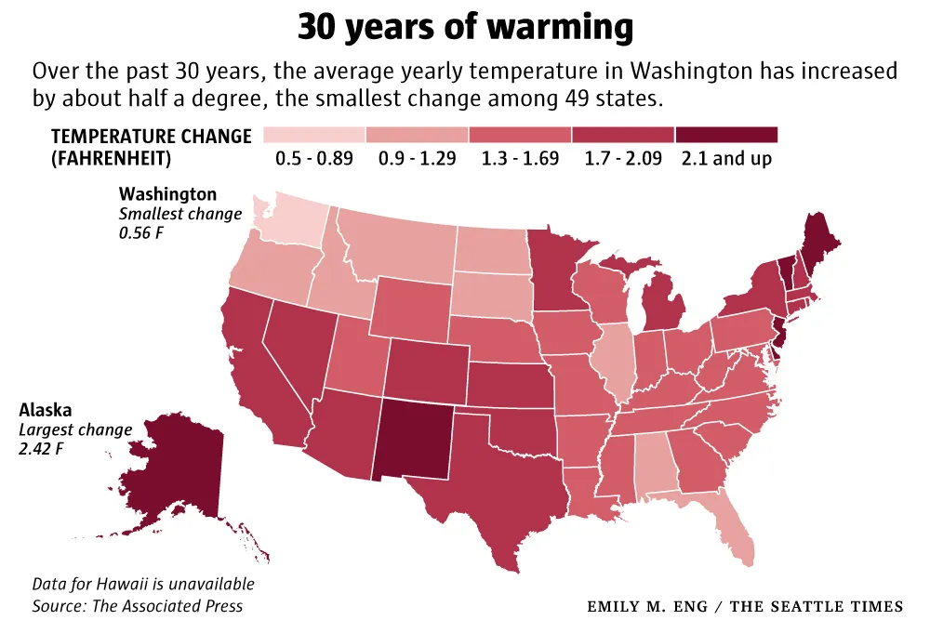
Notes:
Recent warming trend is universal across the US. The temperature change in Washington is lowest in the US in the last 30 years. This is thought to be partially true. We were in a warm season 30 years ago (affecting data) and we have warming moderated by the Pacific Ocean and inland winds coming in from the ocean.

Slide 7
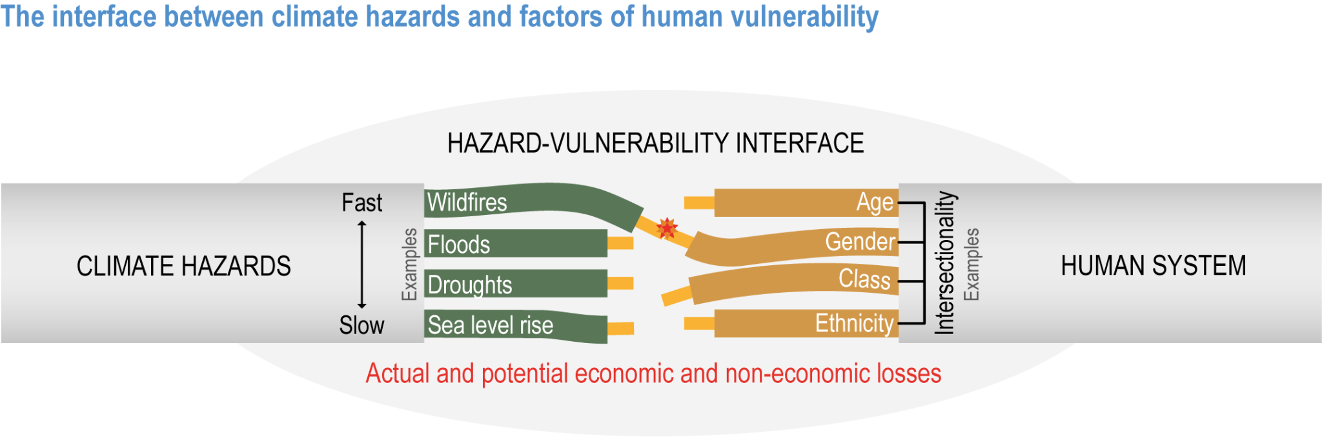
IPCC AR6

Slide 8
You have two figures in front of you. Take a couple minutes to review them and write what you notice. What is surprising? Important?

Slide 9
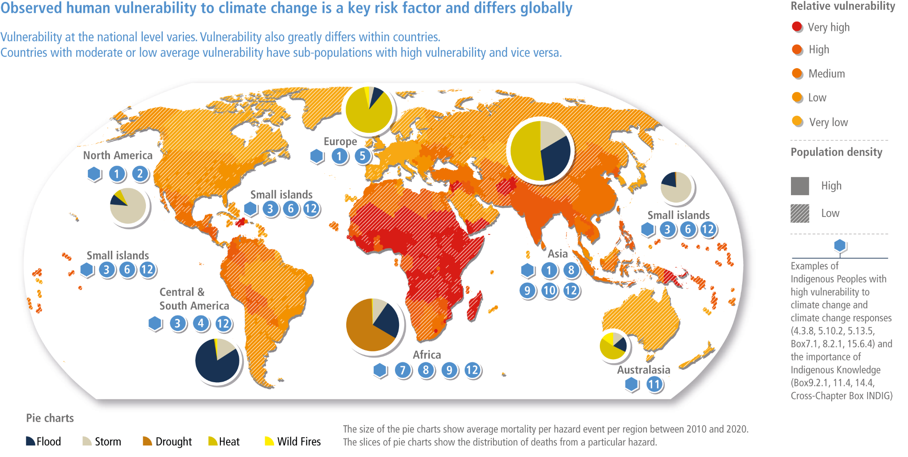
IPCC AR6

Slide 10
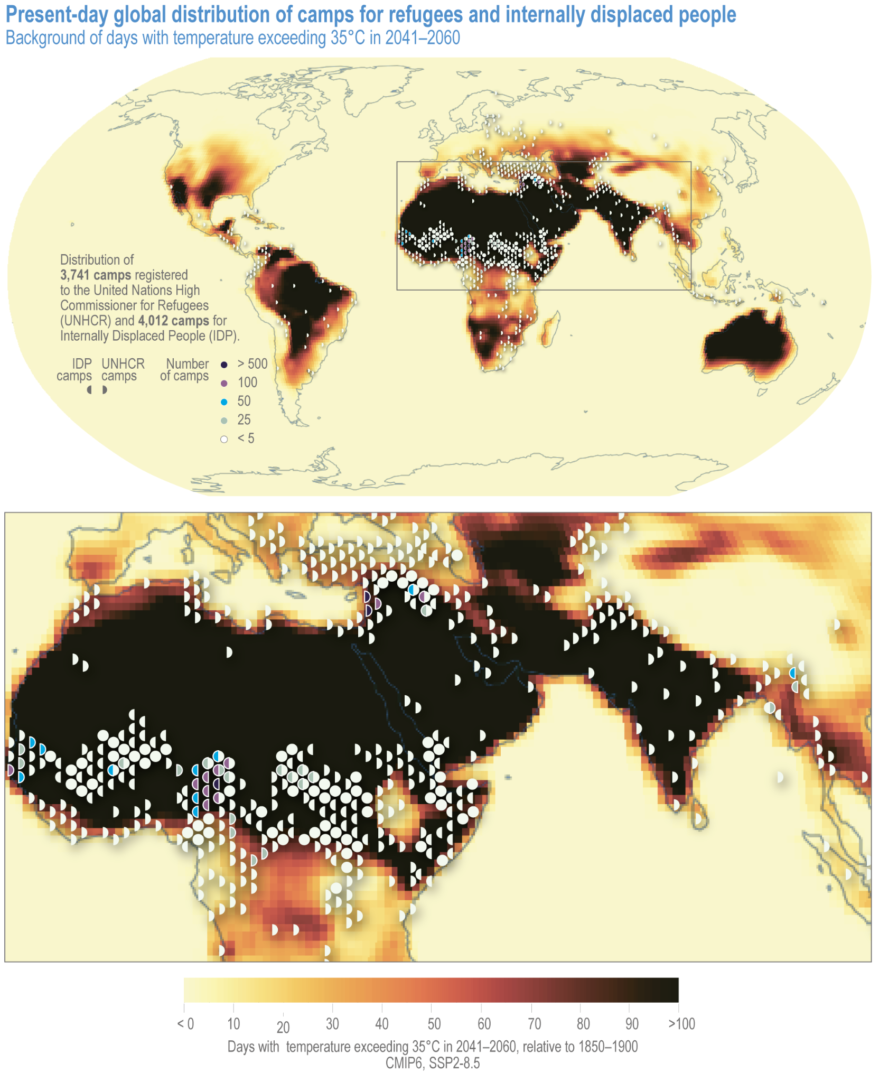
Present-day global distribution of camps for refugees and internally displaced people
Background shows projected days of temperature exceeding 35॰C (95॰F) in 2041-2060
IPCC AR6
Notes:
35 C = 95 F
Jordan: Over a million Syrian refugees and over 2 million Palestinian Refugees (most refugees per capita anywhere)

Slide 11
What do different potential future scenarios look like?

Slide 12
1.5° C of warming by 2100 (RCP 1.9)
Some regions will experience much greater warming that 1.5 degrees.
Global mean sea level rise from 0.26 to 0.77 meters (10-30 inches) by 2100.
Increase of extreme heat and overall number of hot days.
70-90% of coral reefs bleached.
About 4% of the Earth’s land area will transform to a different ecosystem.
Notes:
Increase in temperature extremes: The overall message is that there is no single 1.5-degree world; many regions will experience much greater warming than 1.5 degrees. During the summer in mid-latitudes, increases of up to 3 degrees C in extreme temperature may occur, with the strongest warming happening in central and eastern North America, central and southern Europe, the Mediterranean, western and central Asia, and southern Africa. During the winter in high-latitudes, increases of up to 4.5 degrees C may occur.
Coral bleaching: Many societies depend on coral reefs for fisheries and tourism. Reefs protect the shoreline from storm surge and erosion, among other benefits.
Coral bleaching is the stress-induced expulsion of symbiotic algae (zooxanthellae) from coral tissue, causing the coral to lose its color and turn white. While the coral is not dead when bleached, it is under stress, more vulnerable to starvation and disease, and may die if stressful conditions, such as rising water temperatures due to climate change, persist.
Severe heat waves: defined as having a Heat Wave Magnitude Index daily greater than 20. The Heat Wave Magnitude Index takes into account both heat wave duration and intensity
Updated: September 2020
Sources:
1. IPCC, 2018: Summary for Policymakers. In: Global Warming of 1.5°C. An IPCC Special Report on the impacts of global warming of 1.5°C above pre-industrial levels and related global greenhouse gas emission pathways, in the context of strengthening the global response to the threat of climate change, sustainable development, and efforts to eradicate poverty [Masson-Delmotte, V., P. Zhai, H.-O. Pörtner, D. Roberts, J. Skea, P.R. Shukla, A. Pirani, W. Moufouma-Okia, C. Péan, R. Pidcock, S. Connors, J.B.R. Matthews, Y. Chen, X. Zhou, M.I. Gomis, E. Lonnoy, T. Maycock, M. Tignor, and T. Waterfield (eds.)]. World Meteorological Organization, Geneva, Switzerland, 32 pp.
2. Schleussner, C.-F., Lissner, T. K., Fischer, E. M., Wohland, J., Perrette, M., Golly, A., Rogelj, J., Childers, K., Schewe, J., Frieler, K., Mengel, M., Hare, W., and Schaeffer, M.: Differential climate impacts for policy-relevant limits to global warming: the case of 1.5 °C and 2 °C, Earth Syst. Dynam., 7, 327–351, https://doi.org/10.5194/esd-7-327-2016, 2016.
3. Naumann, G. et al. (2018) Global Changes in Drought Conditions Under Different Levels of Warming, Geophysical Research Letters
4. Dosio, A., L. Mentaschi, E.M. Fischer, and K. Wyser, 2018: Extreme heat waves under 1.5°C and 2°C global warming. Environmental Research Letters, 13(5), 054006, doi:10.1088/1748-9326/aab827.

Slide 13
2° C of warming by 2100 (RCP 2.5)
Over 50% of the world's population exposed to lethal heat for more than 20 days per year.
Risk of river flooding more than doubles
Severe droughts that used to happen once a decade will happen two to three times as often.
The arctic ocean, could become ice free in the summer about once per decade.
Sea levels are projected to rise by 0.36 to 0.87 meters (1.18-2.85 feet) by 2100.
Notes:
Notes:
Lethal heat is based on the body’s inability to cool itself. This is based both on temperature AND humidity. Humidity controls the potential for energy loss through evaporation of sweat
Flooding: This does not include impacts from flash floods, pluvial floods (when extreme rainfall means that the ground cannot absorb the water), and coastal floods.
Coral bleaching: Many societies depend on coral reefs for fisheries and tourism. Reefs protect the shoreline from storm surge and erosion, among other benefits.
Updated: September 2020
Sourcess:
1. Alfieri, L., Bisselink, B., Dottori, F., Naumann, G., de Roo, A., Salamon, P., Wyser, K. and Feyen, L. (2017), Global projections of river flood risk in a warmer world. Earth's Future, 5: 171-182. doi:10.1002/2016EF000485
2. Schleussner, C.-F., Lissner, T. K., Fischer, E. M., Wohland, J., Perrette, M., Golly, A., Rogelj, J., Childers, K., Schewe, J., Frieler, K., Mengel, M., Hare, W., and Schaeffer, M.: Differential climate impacts for policy-relevant limits to global warming: the case of 1.5 °C and 2 °C, Earth Syst. Dynam., 7, 327–351, https://doi.org/10.5194/esd-7-327-2016, 2016.
3. Naumann, G. et al. (2018) Global Changes in Drought Conditions Under Different Levels of Warming, Geophysical Research Letters
4. Mora, C., Dousset, B., Caldwell, I. et al. Global risk of deadly heat. Nature Clim Change 7, 501–506 (2017). https://doi.org/10.1038/nclimate3322

Slide 14
3° C of warming by 2100 (RCP 6.0)
Sea-level rise will will dramatically change present coastlines and be catastrophic for small island nations.
The Arctic could be ice free 2 out of every 3 summers.
In some tropical countries, the combined heat and humidity may be so high during heat waves that it surpasses what human bodies can survive.
Droughts that are currently considered once-in-a-century events could happen every two to five years in much of the world, including the U.S.
Notes:
Arctic sea ice: Melting of Arctic sea ice has a positive feedback effect on global warming, as ice and snow reflect energy from the sun back into space. Without sea ice, more of the energy is absorbed, contributing to further warming. A warming Arctic and lessening sea ice are linked to extreme weather effects in other parts of world, as a result of the global atmospheric circulation. For more on this topic, see https://www.carbonbrief.org/qa-how-is-arctic-warming-linked-to-polar-vortext-other-extreme-weather
Insects: Insects are important as pollinators, for nutrient cycling, and for breaking down waste, among other services. They are the major or sole food source for many amphibian, reptile, bird, and mammal species.⁵
Updated: September 2020
Sourcess:
1. Sigmond, M., Fyfe, J.C. & Swart, N.C. Ice-free Arctic projections under the Paris Agreement. Nature Clim Change 8, 404–408 (2018). https://doi.org/10.1038/s41558-018-0124-y
2. Warren, R., et al. "The projected effect on insects, vertebrates, and plants of limiting global warming to 1.5 C rather than 2 C." Science 360.6390 (2018): 791-79
3. Naumann, G. et al. (2018) Global Changes in Drought Conditions Under Different Levels of Warming, Geophysical Research Letters
4. Turco, M. et al. (2018) Exacerbated fires in Mediterranean Europe due to anthropogenic warming projected with nonstationary climate-fire models, Nature Communications. https://www.nature.com/articles/s41467-018-06358-z
5. https://www.si.edu/spotlight/buginfo/benefits
Photos:
Arctic: https://pixabay.com/images/id-1913559/
Trees: https://pixabay.com/images/id-947331/
Bee: https://pixabay.com/images/id-4243850/
Wildfire: https://www.flickr.com/photos/slworking/29034137667

Slide 15
Which scenario is most likely?

Slide 16
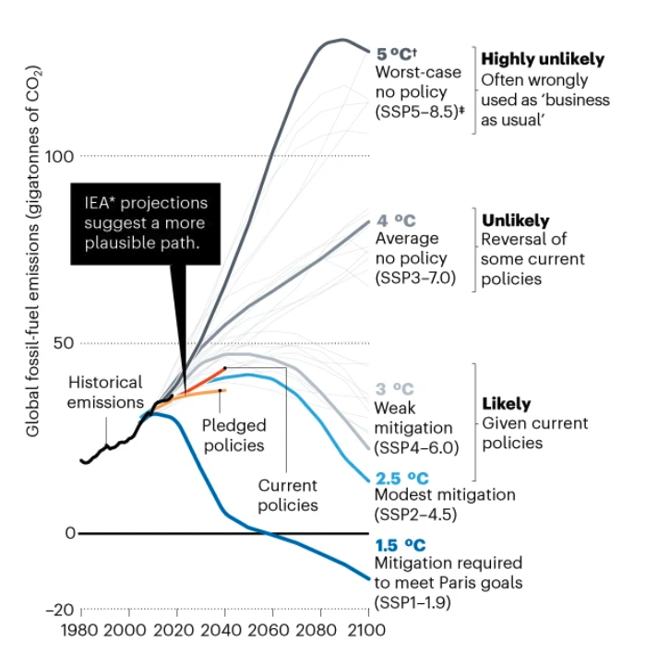
Which scenario is most likely?
We’re not on track for RCP 2.6 (1°C)
RCP 8.5 (3+°C) is less and less plausible
Current policy aligned with about 3°C
Global targets 1.5-2°C
https://www.nature.com/articles/d41586-020-00177-3
Notes:
https://www.nature.com/articles/d41586-020-00177-3

Slide 17
Maintaining a Livable Planet

Slide 18
The sooner we can stop the emissions of greenhouse gases, the better.
Copenhagen Accord (2009): “the increase in global temperature should be below 2° C.”
We have already raised the temperature 1° C, which has caused more damage than expected.
Widespread agreement that 2° C is the desired maximum but limiting warming to 1.5° C is better.

Slide 19
Our Carbon Budget
How much CO2 can we afford to “spend” to keep the planet within 2 degrees C?
We can only put this much more CO2 into the atmosphere.
If we want to limit global warming to this temperature…
360 Gt
1.5° C
Remaining carbon budget 2021, GtCO2.
Adapted from Carbon Tracker Initiative

Slide 20
Our Carbon Budget
How much CO2 can we afford to “spend” to keep the planet within 2 degrees C?
660 Gt
1.7° C
360 Gt
1.5° C
Remaining carbon budget 2021, GtCO2.
Adapted from Carbon Tracker Initiative

Slide 21
Our Carbon Budget
How much CO2 can we afford to “spend” to keep the planet within 2 degrees C?
1110 Gt
For a 66% chance to keep warming to 1.5° C, the amount of CO2 emissions that can be released in the atmosphere is about 360 Gt.
2° C
660 Gt
1.7° C
360 Gt
1.5° C
Remaining carbon budget 2021, GtCO2.
Adapted from Carbon Tracker Initiative

Slide 22
Our Carbon Budget
How much CO2 can we afford to “spend” to keep the planet within 2 degrees C?
1110 Gt
900 Gt
For a 66% chance to keep warming to 1.5° C, the amount of CO2 emissions that can be released in the atmosphere is about 360 150 Gt.
2° C
660 Gt
450 Gt
1.7° C
360 Gt
150 Gt
1.5° C
Since this graphic was made, we have released ~210 Gt
Remaining carbon budget 2021, GtCO2.
Adapted from Carbon Tracker Initiative

Slide 23
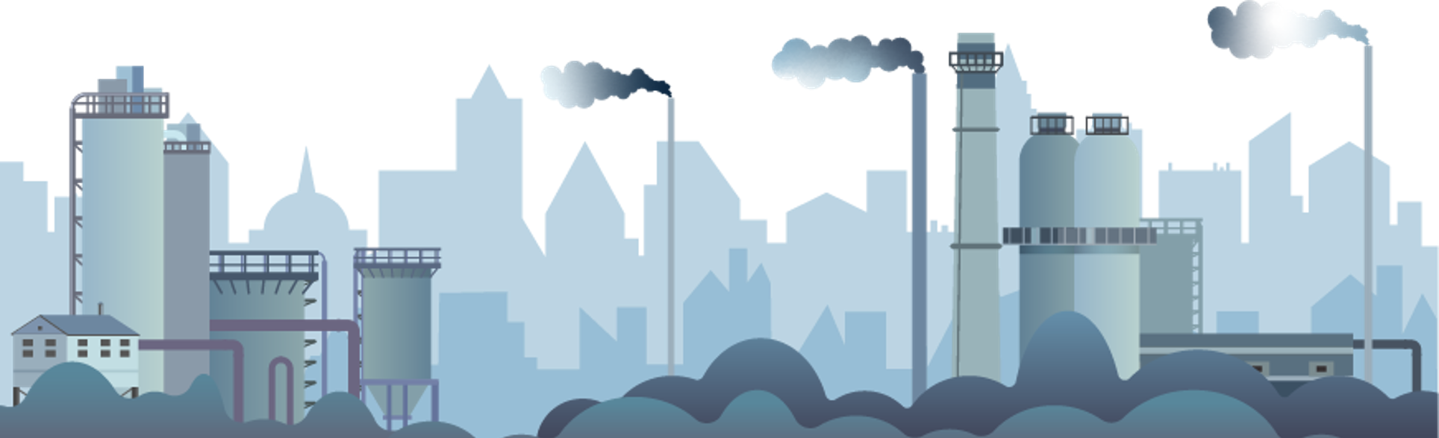
Current
Emissions
As of 2026, at that rate of emissions, we only have ~4 years to achieve a 1.5° C outcome and only ~10 years for the 1.7° C target.
We are currently emitting about 41.6 Gt CO2 each year.
Notes:
This value is still the case, so we have used up around 3 years along this path

Slide 24
Oil, gas, and coal development is not aligned with this carbon budget.
Known global reserves need to stay in the ground, including 80% of coal, 50% of gas, and 33% of oil reserves
Oil and gas wells currently in operation contain 942 Gt
2,795 Gt are already financially “on the books”
Far more oil, gas, and coal are set to be developed than what will keep global warming below 2°C
Carbon Tracker Initiative
Notes:
Remaining known reserves that need to remain unextracted and unused
If we fully extract from currently operational wells, we will release 942 Gt
‘On the books’ meaning materials that companies and governments have already counted as part of their financial value which they expect to extract and profit from

Slide 25
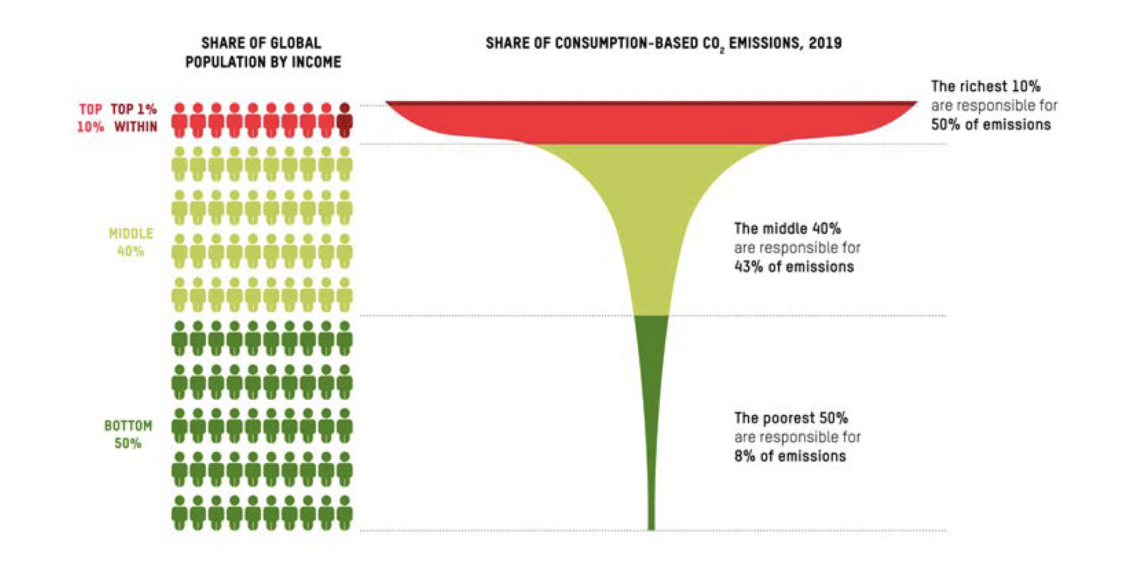
Oxfam & Stockholm Environmental Institute
https://oxfamilibrary.openrepository.com/bitstream/handle/10546/621551/cr-climate-equality-201123-en-summ.pdf;jsessionid=A2310D4366609101EA722BCD0A7CF02F?sequence=1
Notes:
The world’s wealthiest 1% (63 million) are responsible for more than twice as much carbon pollution as the poorest 50% (3.1 billion).
The inequality is so great that the poorest 50% could increase their their emissions, and quality of life, and we could still stay within 1.5 - 2° global warming targets
Some people can (and must) do more than others.

Slide 26
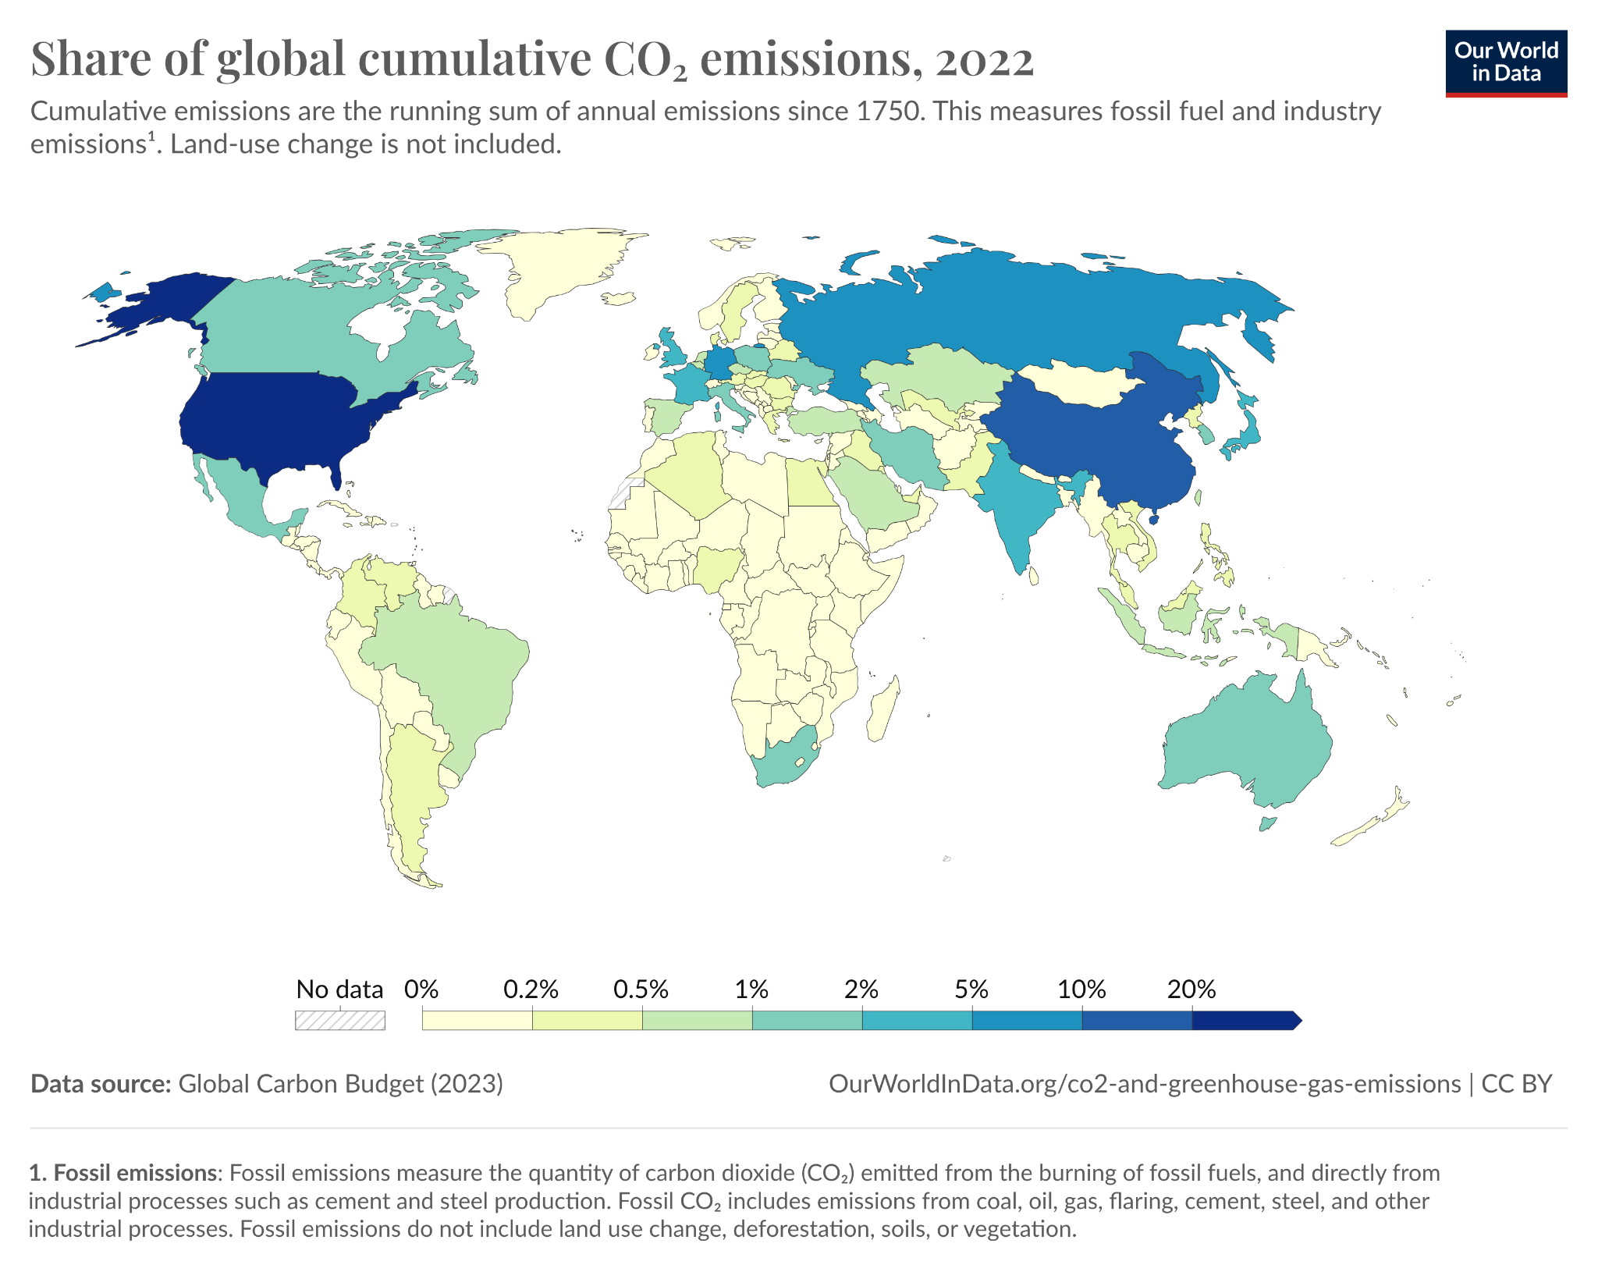
GHG’s stay in the atmosphere for varying amounts of time
Many countries, including the US, built their wealth and lifestyle on high emissions
They could use their wealth and infrastructure to develop low-carbon pathways for the rest of the world.

Slide 27
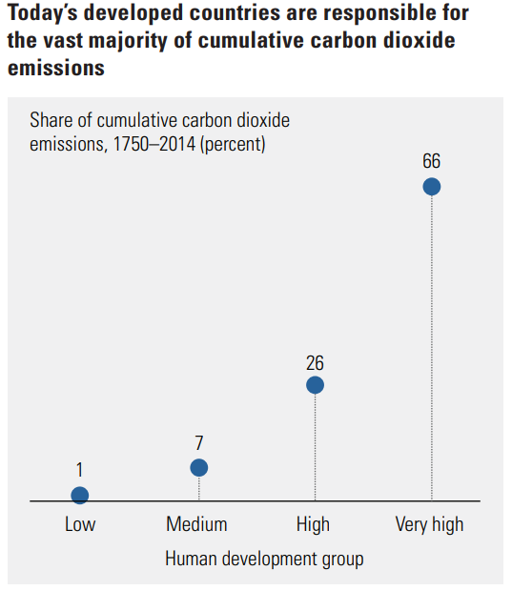
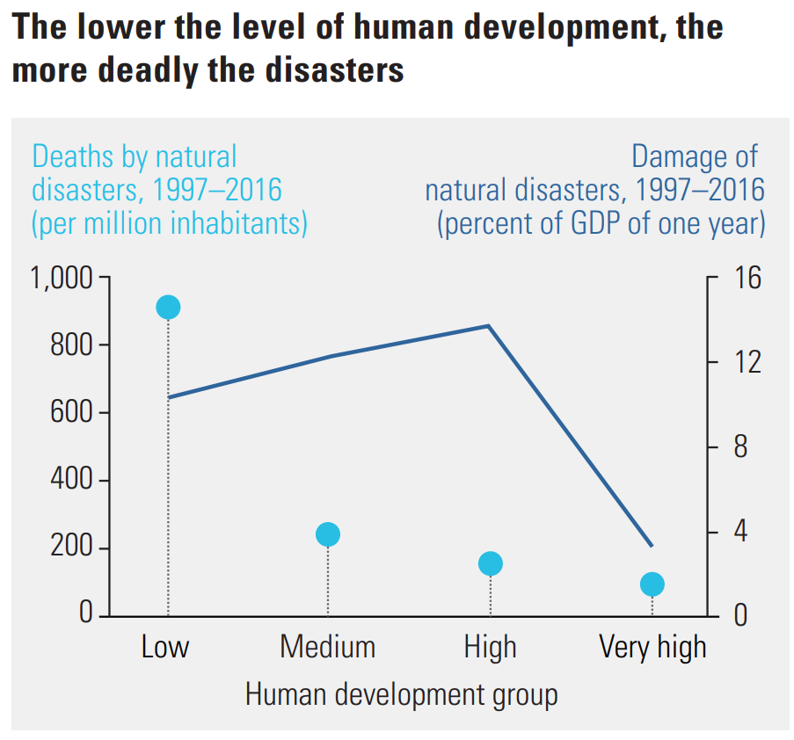
Human Development Report

Slide 28
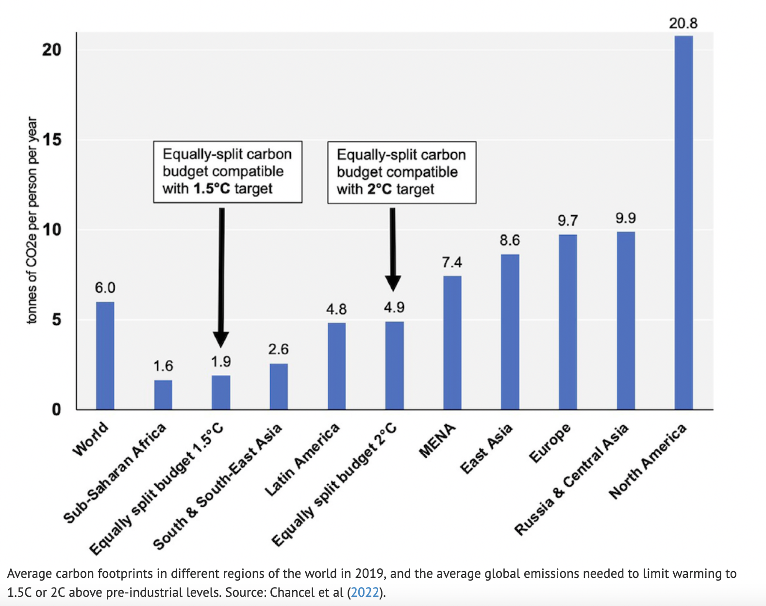
Chancel, 2022: Per-capita budgets needed to avoid 2 degrees warming

Slide 29
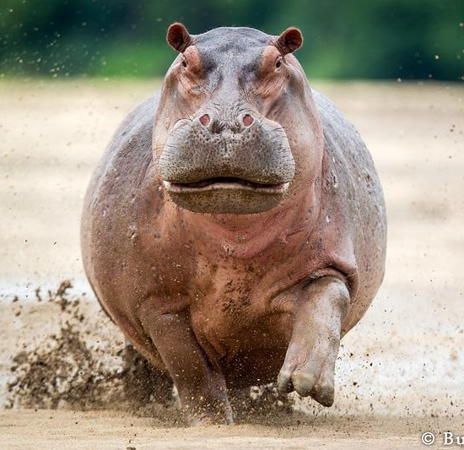
Chancel, 2022: Per-capita budgets needed to avoid 2 degrees warming

Slide 30
Chancel, 2022: Per-capita budgets needed to avoid 2 degrees warming
16 GtC/yr

Slide 31
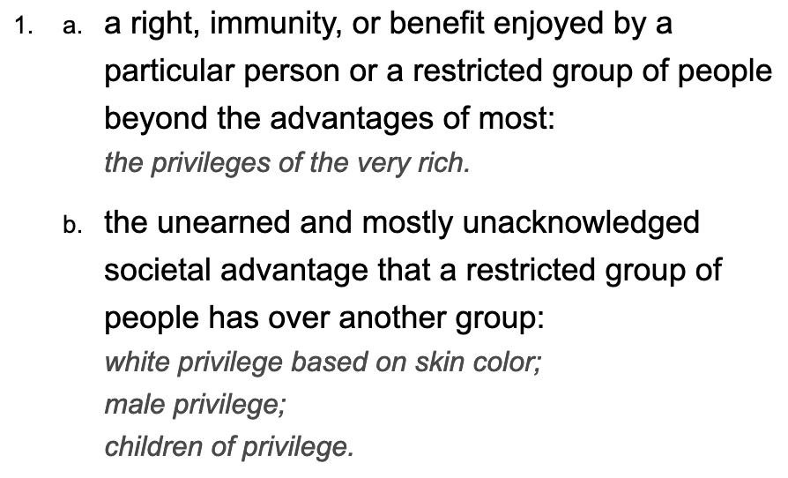
“Carbon Privilege” would seem to be an appropriate term for this
My lifetime carbon emissions due to flying.
Dictionary.com

Slide 32
Chancel, 2022: Per-capita budgets needed to avoid 2 degrees warming
Carbon Privilege = 16 tC/yr

Slide 33
Next: Exploring our personal connections to climate change

